Slide 1

Designing a Simple Network
Risala T Khan
Professor
IIT, JU

Slide 2

What is network
When two or more devices are connected in such a way that they can share their data, information as well as their resources then it forms network.
When two or more networks or subnets connected to each other for communication between hosts on different types of network then it forms internetwork.

Slide 3
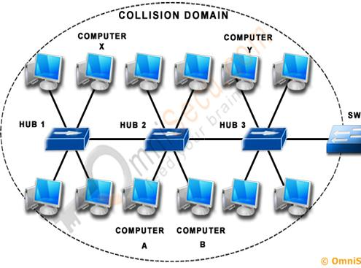
Collision Domain
A collision domain is a network segment connected by a shared medium or through repeaters where simultaneous data transmissions collide with one another.
The collision domain defines the set of devices on which their frames could collide.
A network collision occurs when more than one device attempts to send a packet on a network segment at the same time.
Devices outside the collision domain do not have collisions with those inside.
Only one device in the collision domain may transmit at any one time, and the other devices in the domain listen to the network and refrain from transmitting while others are already transmitting in order to avoid collisions.
Collisions also decrease network efficiency on a collision domain as collisions require devices to abort transmission and retransmit at a later time.

Slide 4
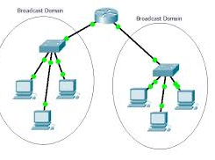
Broadcast Domain
In networking, a broadcast means that we send something that everyone receives, whether they need/want it or not. Switches will forward broadcast traffic on all their interfaces, except the one they received the broadcast on.
However, all port on a router are in the distinct broadcast domains, and routers never broadcast from one Domain to another.

Slide 5
Collision vs Broadcast Domain
Collision Domain | Broadcast Domain
1. The Collision domain is a network section that allows traffic to flow forward and backward. | A Broadcast domain is a type of Domain wherein traffic flows all over the network.
2. The Collision domain refers to a set of devices in which packet collision could occur. | Broadcast domain refers to a logical set of reachable computer systems without using a router.
3. Packet collision occurs as multiple devices transmit data on a single wire link. | The broadcast domain mostly uses a switched environment to broadcast, so no collision occurs.
4. Switches will break in the collision domain | Switches will never break in the broadcast domain.
5. In, collision domain, every port on a router are in the separate broadcast domains. | All ports on a switch or a hub likely to be in the same broadcast domain.

Slide 6
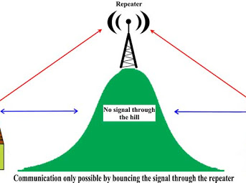
Repeater
A repeater operates at the physical layer.
Its job is to regenerate the signal over the same network before the signal becomes too weak or corrupted so as to extend the length to which the signal can be transmitted over the same network.
An important point to be noted about repeaters is that they do not amplify the signal.
When the signal becomes weak, they copy the signal bit by bit and regenerate it at the original strength. It is a 2 port device.

Slide 7
HUB
A hub is basically a multiport repeater.
A hub connects multiple wires coming from different branches, for example, the connector in star topology which connects different stations.
Hubs cannot filter data, so data packets are sent to all connected devices.
In other words, collision domain of all hosts connected through Hub remains one.
Also, they do not have the intelligence to find out best path for data packets which leads to inefficiencies and wastage.

Slide 8
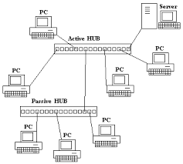
Types of Hub
Active Hub:- These are the hubs which have their own power supply and can clean, boost, and relay the signal along with the network. It serves both as a repeater as well as wiring centre. These are used to extend the maximum distance between nodes.
Passive Hub :- These are the hubs which collect wiring from nodes and power supply from active hub. These hubs relay signals onto the network without cleaning and boosting them and can’t be used to extend the distance between nodes.
Intelligent Hub :- It work like active hubs and include remote management capabilities. They also provide flexible data rates to network devices. It also enables an administrator to monitor the traffic passing through the hub and to configure each port in the hub.

Slide 9
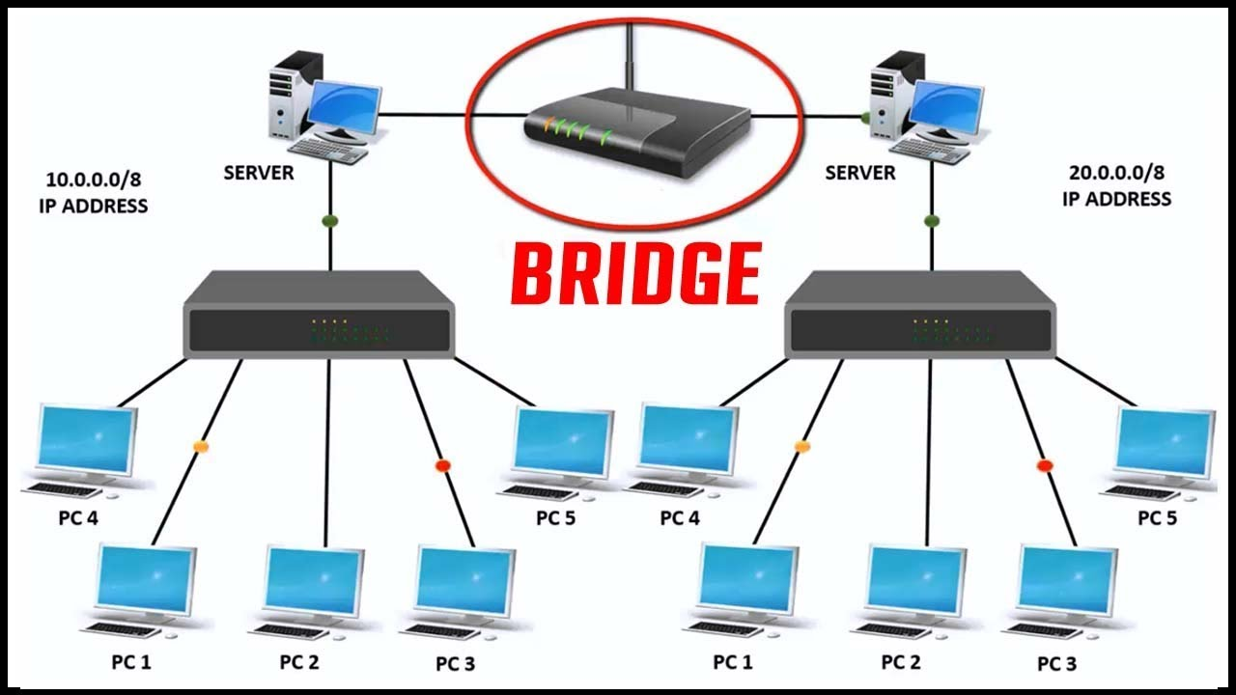
Bridge
A bridge operates at data link layer.
Bridges can divide large network into smaller segments.
A bridge is a repeater, with add on the functionality of filtering content by reading the MAC addresses of source and destination.
It is also used for interconnecting two LANs working on the same protocol.
It has a single input and single output port, thus making it a 2 port device.

Slide 10
How Bridge Works
Bridges can creates routing table.
Routing table is built to record the segment no. of address.
If destination address is in the same segment as the source address, stop transmit otherwise, forward to the other segment.

Slide 11
Types of Bridges
1.Simple bridge
• Simple bridge links two segments and contains a table that lists the addresses of all stations included in each of them.
• Most primitive and least expansive.
• Time consuming.
2.Multiport bridge
• Multiport bridge can be used to connect more than two LANS.
• In this bridge three tables are created, each one holding the physical address of station reachable through the corresponds port.
3.Transparent bridge
• Transparent bridge builds table automatically by frame movements in network. • A bridge observes each frame that arrives at a port, extracts the source address from the frame, and places that address in the port’s routing table.
• It has self updating feature.

Slide 12
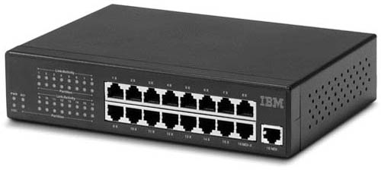
Switch
A switch is a multiport bridge with a buffer and a design that can boost its efficiency(a large number of ports imply less traffic) and performance.
A switch is a data link layer device.
The switch can perform error checking before forwarding data, that makes it very efficient as it does not forward packets that have errors and forward good packets selectively to correct port only.
In other words, switch divides collision domain of hosts, but broadcast domain remains same

Slide 13
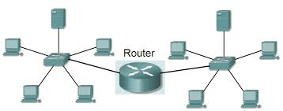
Router
A router is a device like a switch that routes data packets based on their IP addresses.
Router is mainly a Network Layer device.
Routers normally connect LANs and WANs together and have a dynamically updating routing table based on which they make decisions on routing the data packets.
Router divide broadcast domains of hosts connected through it.

Slide 14
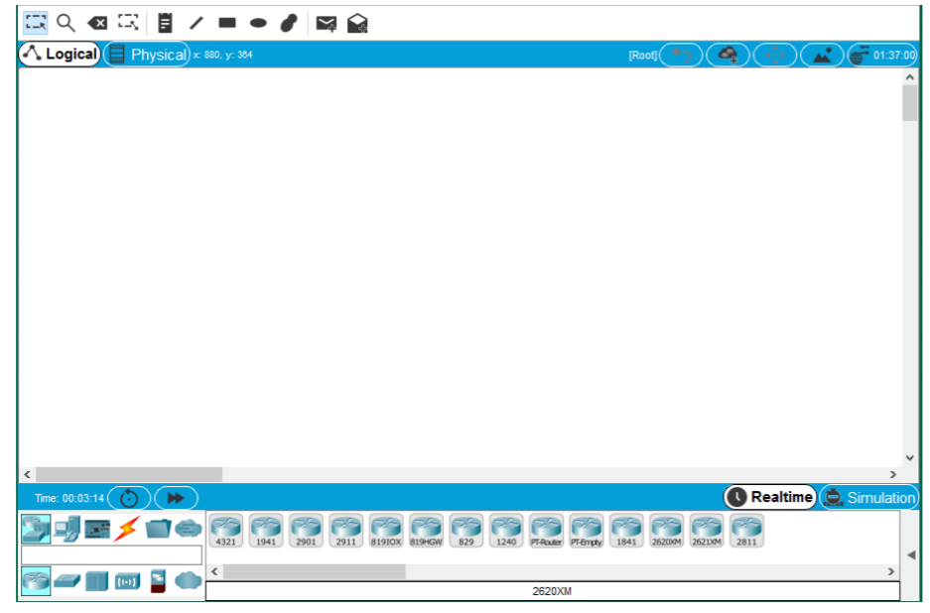
Launch Packet Tracer

Slide 15
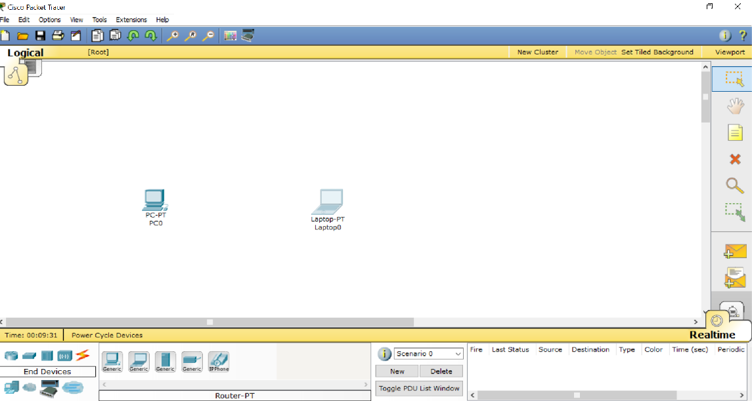
Building P2P Network
Choosing End Devices
Choice of end devices is perfectly flexible.
You can select and use any type of end device from tools menu.
I will be using simple computers as end devices.
So, first select two desktop computers from the end devices tools menu and drop it on drawing area.

Slide 16
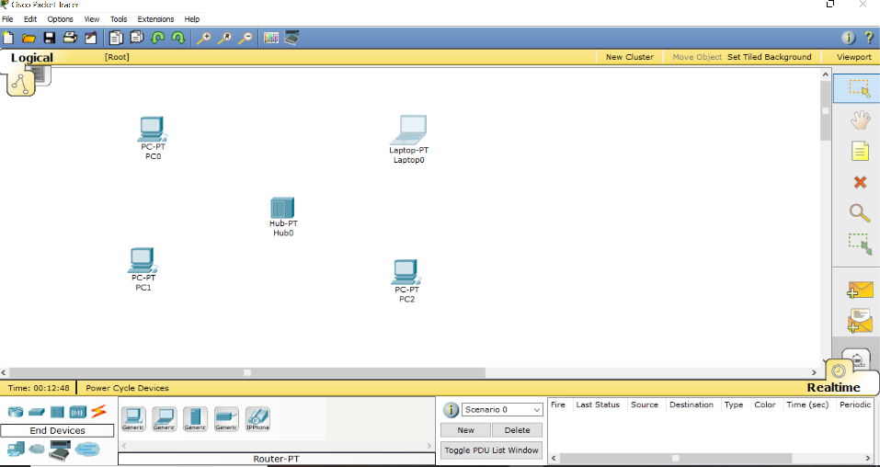
Building P2P Network
Select Network Device
You have plenty of options in choosing network device for interconnection of network nodes.
I will be using a hub for this purpose.
So, again go to the tools menu and select Hubs menu.
You can use any model of hub. Simply draw hub on the drawing area as you have did before.

Slide 17
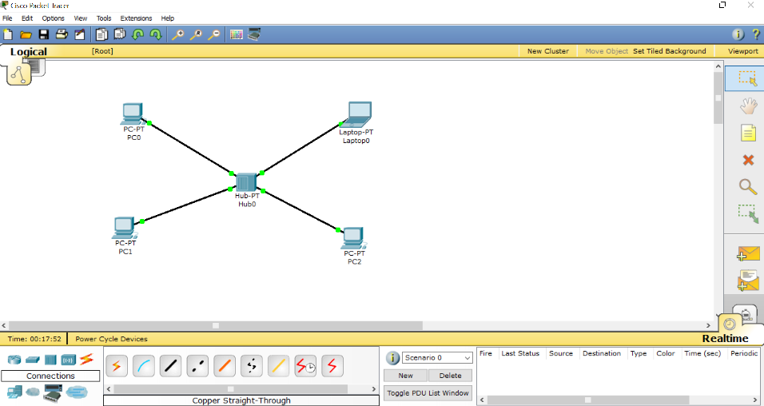
Building P2P Network
Establish Communication Links
In this step, you will simply use communication cable for establishing communication channels.
To accomplish this, simply move to the connections from tools menu.
You will find a lot of different types of communication cables.
Simply go for copper straight through cable.
Connect each end device to the central network device.

Slide 18
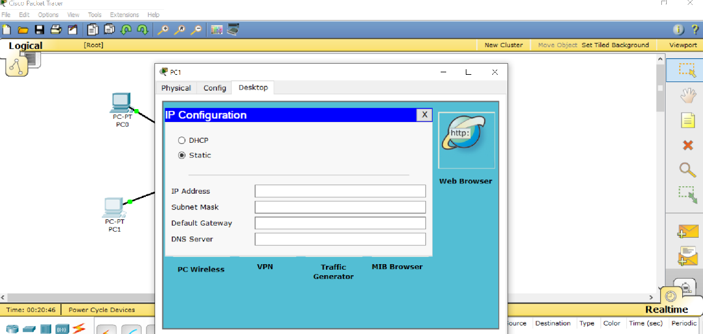
Building P2P Network
Configure IP Address of Each End Device
This step involves assignment of IP addresses to each individual computer.
For this, simple click on a computer.
You will be seeing a dialog box. This box contains different configuration settings.
Move to the desktop tab. In desktop tab click on IP Configuration option.

Slide 19

Class Work
Build the same network using SWITCH

